Slide 1
Models for Understanding and Controlling Global Infectious Diseases HUMBIO 154D / HRP 204
Session 3
Jason Andrews
Jeremy Goldhaber-Fiebert
2020

Slide 2
5-10 minuteS OF lecture 2 Recap: JASON ANDREWS

Slide 3
Course Roadmap
First Models
SIR models with demography
Reproductive Number, Thresholds, Equilibria
Lab: Dynamic Models in R
Heterogeneous mixing and temporal modeling
Emerging infections: takeoff, growth, extinction
Lab: Emerging infections
Vectors, zoonoses, & environmental transmission
Stochastic dynamics
Spatial models, networks
Interventions and sensitivity analyses
Lab: Interventions and sensitivity analyses
Competition and evolutionary models
Within host evolution
Lab on Parameterization, calibration, and uncertainty
Health policy and economic evaluation models
Uses and abuses of models

Slide 4
Practical Questions
How do we describe the long-term dynamics of infectious diseases?
Under what conditions will an infectious disease become and remain endemic in a population?
Do declines in an infectious disease’s prevalence over relatively long time periods necessarily mean that it is dying out in that population?

Slide 5
Learning Objectives
Define relevant demographic features for SIR models
Compare implications for R0 and equilibrium properties for SIR models with and without demography
Consider endemic equilibria and how SIR models predict that prevalence of infections will move towards those equilibria from various initial conditions. For oscillatory equilibria consider drivers of the periods of oscillation
Evaluate how average age of infection can be computed from data and from models
Compare and contrast related models: SIR models with demography and excess mortality, chronic infection models, models with no or waning immunity

Slide 6
Learning Objectives
Define relevant demographic features for SIR models
Compare implications for R0 and equilibrium properties for SIR models with and without demography
Consider endemic equilibria and how SIR models predict that prevalence of infections will move towards those equilibria from various initial conditions. For oscillatory equilibria consider drivers of the periods of oscillation
Evaluate how average age of infection can be computed from data and from models
Compare and contrast related models: SIR models with demography and excess mortality, chronic infection models, models with no or waning immunity

Slide 7

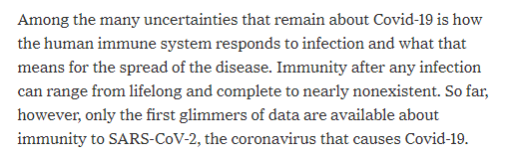
Motivating Example

Slide 8
What is Demography?
Demography is the study of human populations in terms of their size and structure and how processes of birth, death, migration, and aging unfold within them
For our purposes today, we are specifically going to focus on birth and death in the human populations our infectious disease models typically focus on

Slide 9
Survival Curves
% Alive
µ: the mortality rate
Time

Slide 10
Survival Curves
% Alive
Area under curve =
Life expectancy =
1/µ
Time

Slide 11
Mortality in a Simple Model
World’s Simplest Model
% Alive
S
World’s Simplest Model
with Mortality
S
µ
Time

Slide 12
Mortality and Birth in a Simple Model
World’s Simplest Model
with Mortality
% Alive
S
µ
World’s Simplest Model
with Mortality and Birth
S
b
µ
Time

Slide 13
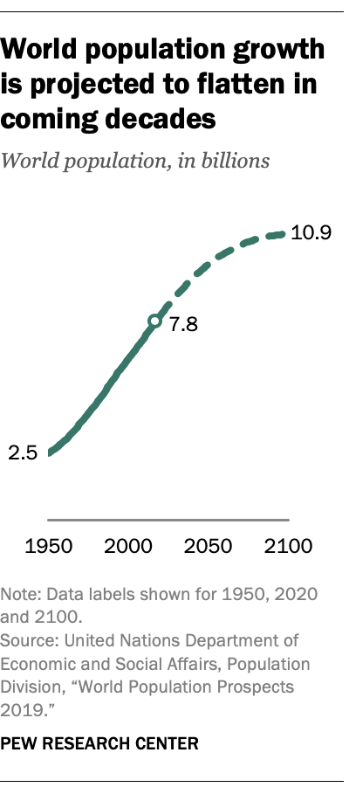
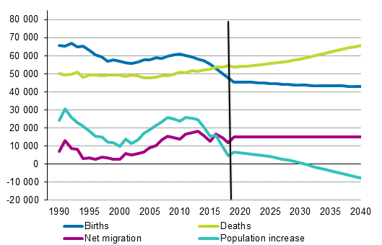
But not everywhere … Finland

Slide 14
Mortality and Birth in SIR Models
S
βI
I
γ
R
b
µ
µ
µ
Basic, Typical Assumptions:
Mortality is the same for all states (not yet incorporating infection-caused excess mortality)
Birth equals death (b = μ) => Population size stable

Slide 15
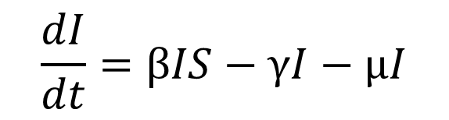
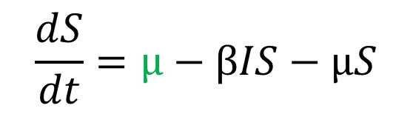
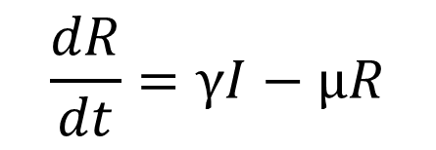
Mortality and Birth in SIR Models: Equations
S
βI
I
γ
R
µ
µ
µ
µ
$$\frac{dS}{dt}=μ−βIS−μS$$
$$\frac{dI}{dt}=βIS−γI−μI$$
$$\frac{dR}{dt}=γI−μR$$

Slide 16
R0 in an SIR model with demography: Requirements for “take off”
S
βI
I
γ
R
µ
µ
µ
µ
$$\frac{dS}{dt}=μ−βIS−μS$$
To determine the Basic Reproductive Number (R0), we first focus on a related concept, the threshold (minimum) fraction of Susceptibles required for infection to “take off”
$$\frac{dI}{dt}=βIS−γI−μI$$
$$\frac{dR}{dt}=γI−μR$$

Slide 17
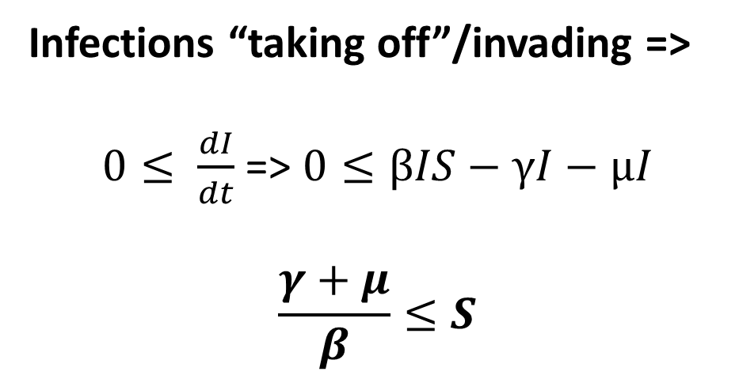
R0 in an SIR model with demography: Requirements for “take off”
S
βI
I
γ
R
µ
µ
µ
µ
$$\frac{dS}{dt}=μ−βIS−μS$$
Infections “taking off”/invading =>
$0≤ \frac{dI}{dt}$ => $0≤βIS−γI−μI$
$$\frac{γ+μ}{β}≤S$$
$$\frac{dI}{dt}=βIS−γI−μI$$
$$\frac{dR}{dt}=γI−μR$$

Slide 18
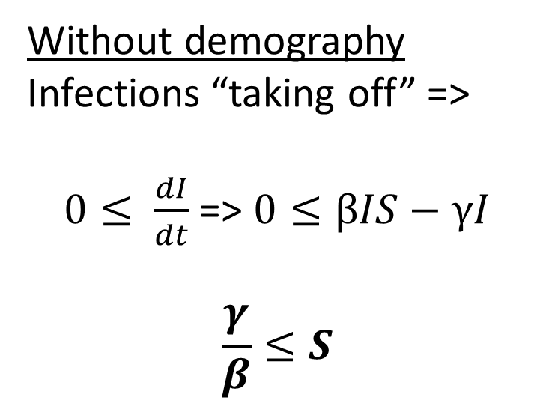
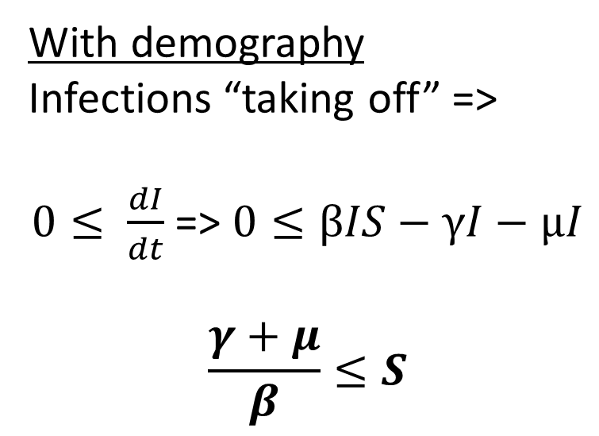
R0 in an SIR model with demography: Requirements for “take off”
With demography
Infections “taking off” =>
$0≤ \frac{dI}{dt}$ => $0≤βIS−γI−μI$
$$\frac{γ+μ}{β}≤S$$
Without demography
Infections “taking off” =>
$0≤ \frac{dI}{dt}$ => $0≤βIS−γI$
$$\frac{γ}{β}≤S$$
The number of Susceptibles required is larger for infections to take off w/ demography than w/o demography. Why?

Slide 19
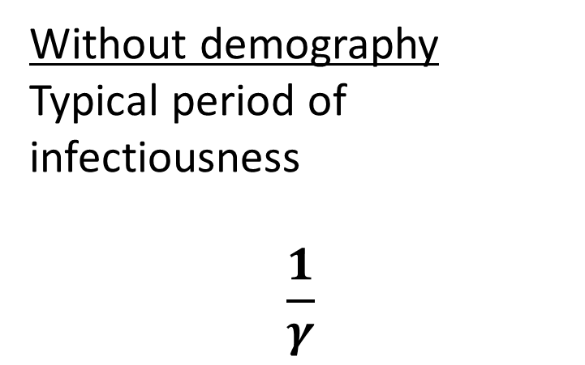
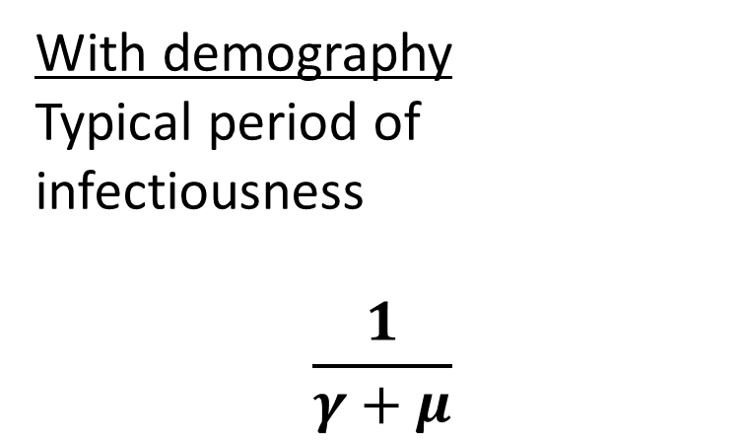
R0 in an SIR model with demography: Requirements for “take off”
With demography
Typical period of infectiousness
$$\frac{1}{γ+μ}$$
Without demography
Typical period of infectiousness
$$\frac{1}{γ}$$
Infectious individual are infectious for shorter periods of time (like Life Expectancy but with competing risks). People stop being infectious when they recover OR die

Slide 20
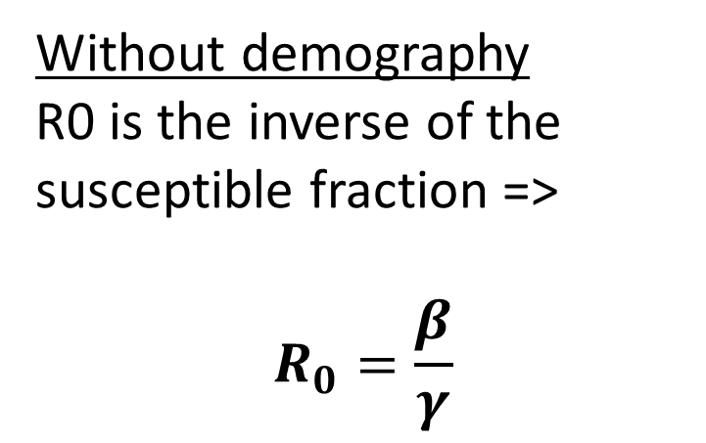
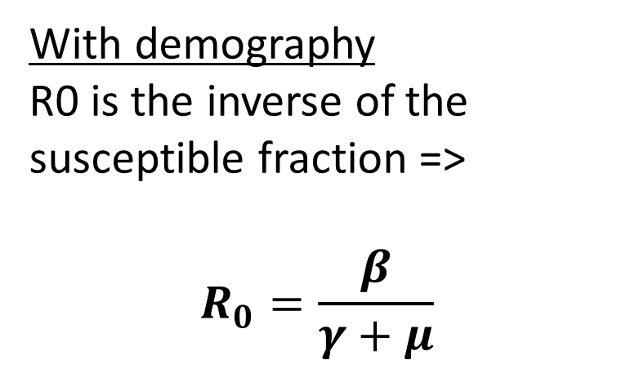
R0 in an SIR model with demography
With demography
R0 is the inverse of the susceptible fraction =>
$$R_{0}=\frac{β}{γ+μ}$$
Without demography
R0 is the inverse of the susceptible fraction =>
$$R_{0}=\frac{β}{γ}$$
$$R_{0,demography }≤R_{0,no_demography }$$

Slide 21
Equilibria and Endemicity
Equilibrium: Within a population, an infectious disease is in equilibrium when its level remains constant over time
Endemic: Within a population, an infectious disease is endemic when it is maintained at a non-zero level

Slide 22
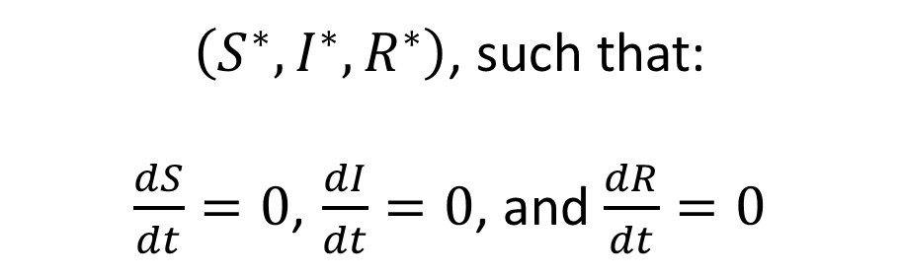
SIR model with demography: Equilibria
S
βI
I
γ
R
µ
µ
µ
µ
$$\frac{dS}{dt}=μ−βIS−μS$$
$\left(S^{∗},I^{∗},R^{∗}\right)$, such that:
$\frac{dS}{dt}=0$, $\frac{dI}{dt}=0$, and $\frac{dR}{dt}=0$
$$\frac{dI}{dt}=βIS−γI−μI$$
$$\frac{dR}{dt}=γI−μR$$

Slide 23
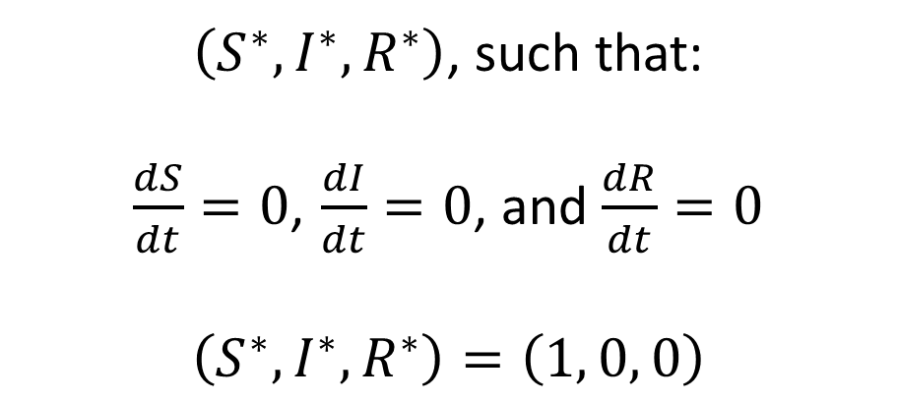
SIR model with demography: Disease- Free Equilibrium
S
βI
I
γ
R
µ
µ
µ
µ
$$\frac{dS}{dt}=μ−βIS−μS$$
$\left(S^{∗},I^{∗},R^{∗}\right)$, such that:
$\frac{dS}{dt}=0$, $\frac{dI}{dt}=0$, and $\frac{dR}{dt}=0$
$$\left(S^{∗},I^{∗},R^{∗}\right)=\left(1, 0, 0\right)$$
$$\frac{dI}{dt}=βIS−γI−μI$$
$$\frac{dR}{dt}=γI−μR$$

Slide 24
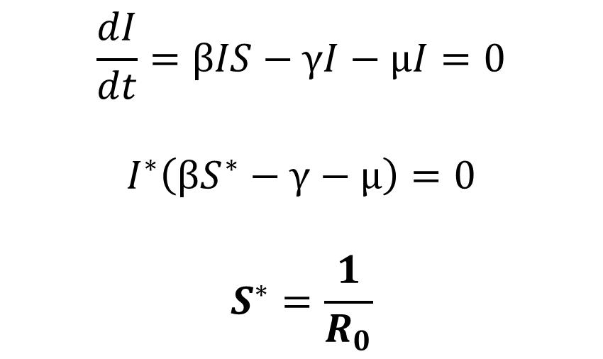
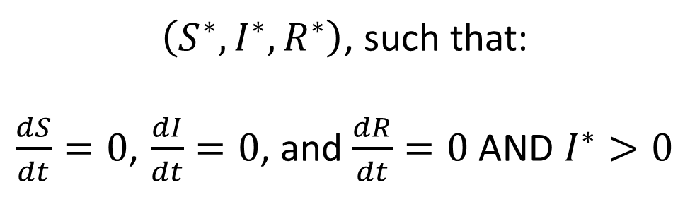
SIR model with demography: Endemic Equilibrium
$\left(S^{∗},I^{∗},R^{∗}\right)$, such that:
$\frac{dS}{dt}=0$, $\frac{dI}{dt}=0$, and $\frac{dR}{dt}=0$ AND $I^{∗}>0$
$$\frac{dI}{dt}=βIS−γI−μI=0$$
$$I^{∗}\left(βS^{∗}−γ−μ\right)=0$$
$$S^{∗}=\frac{1}{R_{0}}$$
The larger R₀, the smaller the fraction of Susceptibles in endemic equilibrium (but there will always be some)

Slide 25
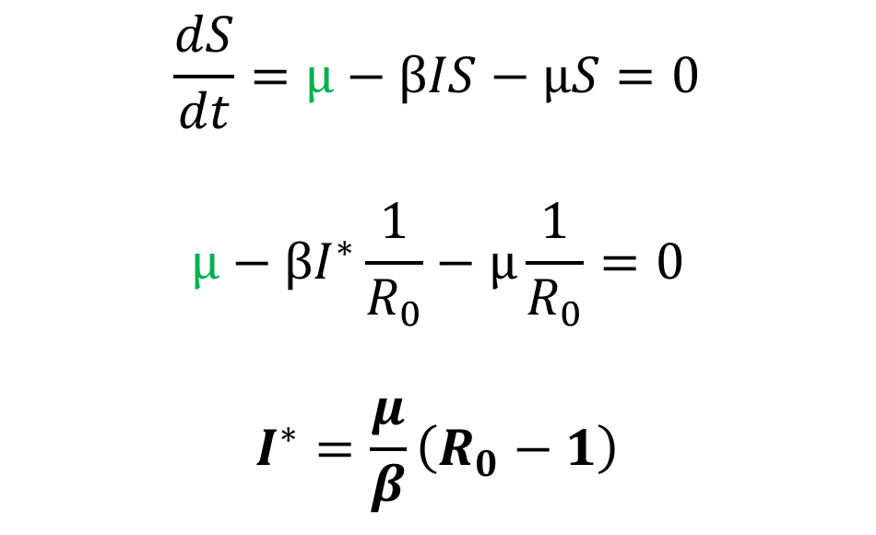
SIR model with demography: Endemic Equilibrium
$\left(S^{∗},I^{∗},R^{∗}\right)$, such that:
$\frac{dS}{dt}=0$, $\frac{dI}{dt}=0$, and $\frac{dR}{dt}=0$ AND $I^{∗}>0$
$$\frac{dS}{dt}=μ−βIS−μS=0$$
$$μ−βI^{∗}\frac{1}{R_{0}}−μ\frac{1}{R_{0}}=0$$
$$I^{∗}=\frac{μ}{β}\left(R_{0}−1\right)$$
R₀ > 1 for endemic equilibrium because
Infection must sustain itself

Slide 26
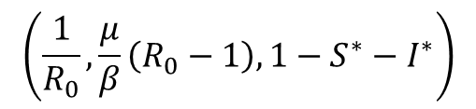
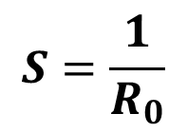
SIR model with demography: Equilibria and Stability
$$\left(\frac{1}{R_{0}},\frac{μ}{β}\left(R_{0}−1\right),1−S^{∗}−I^{∗}\right)$$
I Prevalence
(1, 0, 0)
R₀ < 1, Endemic equilibrium is not feasible
$$S=\frac{1}{R_{0}}$$
S Prevalence

Slide 27
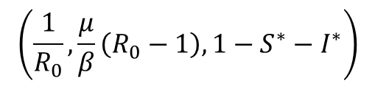
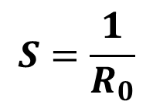
SIR model with demography: Equilibria and Stability
$$\left(\frac{1}{R_{0}},\frac{μ}{β}\left(R_{0}−1\right),1−S^{∗}−I^{∗}\right)$$
If R₀ is 1+, Endemic equilibrium is feasible and stable
(See Box 2.4 for formal Jacobian and Eigenvalue approach to assessing stability)
I Prevalence
(1, 0, 0)
$$S=\frac{1}{R_{0}}$$
S Prevalence

Slide 28
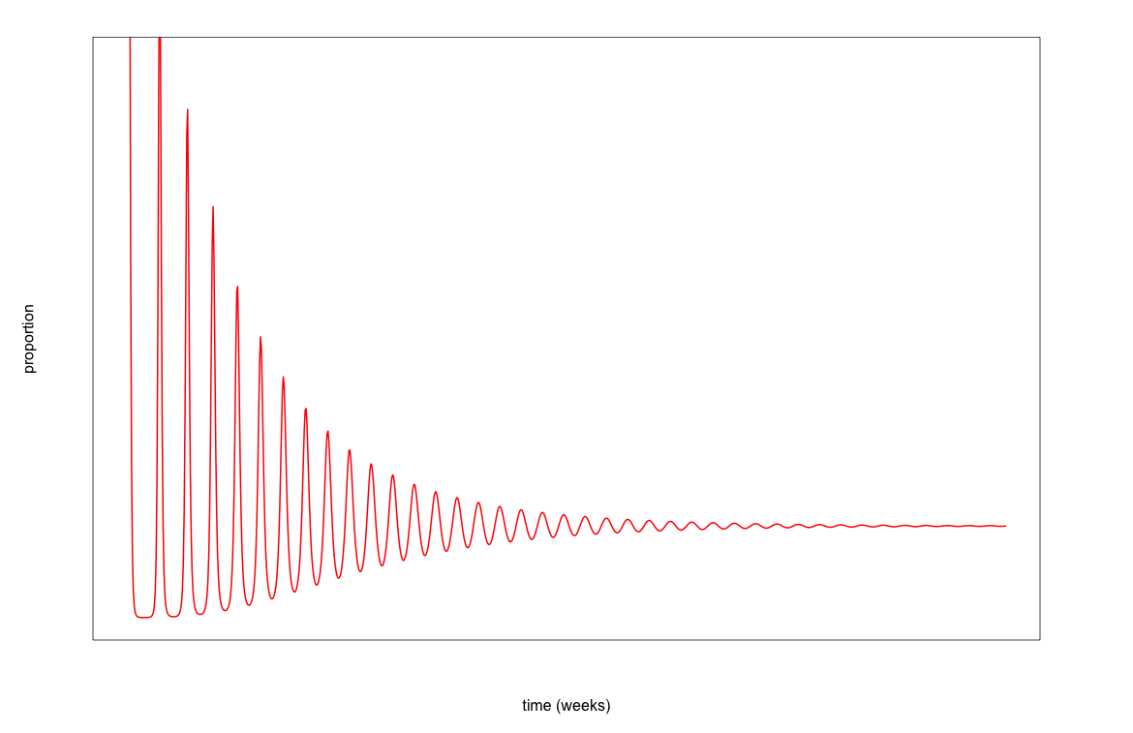
SIR model with demography: Damped Oscillatory Dynamics

Slide 29
SIR model with demography: Period of Oscillation
Holding μ fixed and assuming b=μ, oscillatory period depends on β and γ

Slide 30
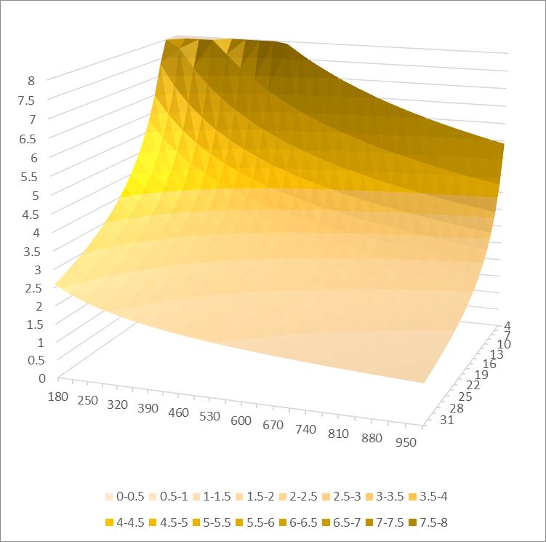
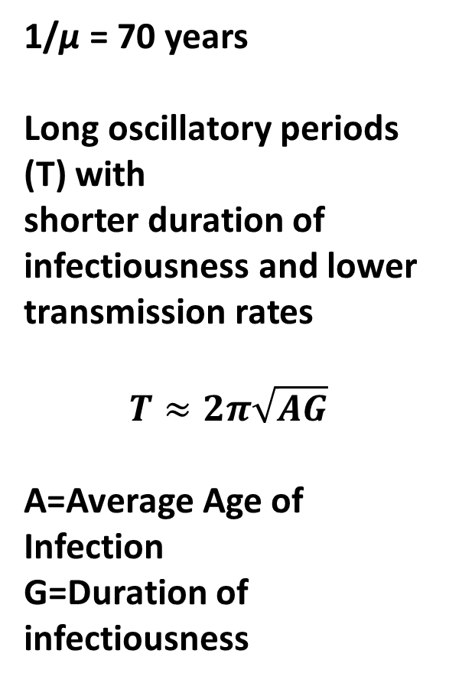
SIR model with demography: Period of Oscillation
1/μ = 70 years
Long oscillatory periods (T) with
shorter duration of infectiousness and lower transmission rates
$$T≈2π\sqrt{AG}$$
A=Average Age of Infection
G=Duration of infectiousness
I Duration in days
Transmission rate per year

Slide 31
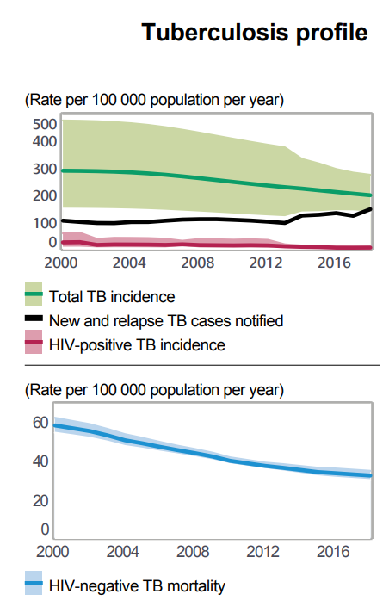
Tuberculosis
TB is caused by Mycobacterium tuberculosis
It affects the lungs (and other parts of the body less commonly).
Active untreated TB infections lead to fever, cough, night sweats, and blood in sputum. They have a ~75% case fatality rate.
TB infection is spread through the air via cough, breathing, and spitting.
India
Notes:
https://extranet.who.int/sree/Reports?op=Replet&name=%2FWHO_HQ_Reports%2FG2%2FPROD%2FEXT%2FTBCountryProfile&ISO2=IN&LAN=EN&outtype=html

Slide 32
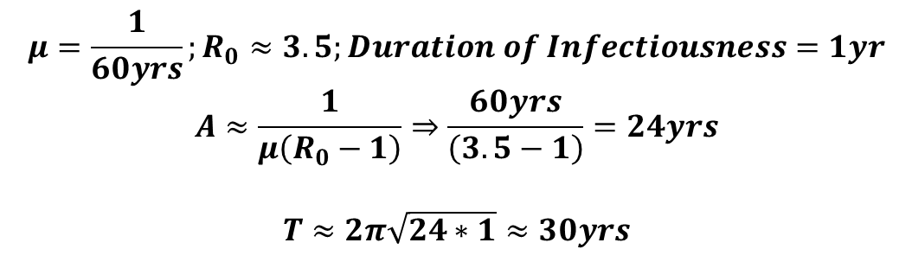
Is Tuberculosis on its way to elimination in India?
15 yrs
TB Prevalence
Time
$$μ=\frac{1}{60yrs};R_{0}≈3.5;Duration of Infectiousness=1yr$$
$$A≈\frac{1}{μ\left(R_{0}−1\right)}⇒\frac{60yrs}{\left(3.5−1\right)}=24yrs$$
$$T≈2π\sqrt{24∗1}≈30yrs$$
Notes:
https://www.ncbi.nlm.nih.gov/pmc/articles/PMC6092233/pdf/nihms973153.pdf

Slide 33
SIR model with demography: Average Age of Infection
Seroprevalence survey:
Random sample of population to determine % of population in each age group that has antibodies to a particular pathogen (those that are Recovered and immune)
We can determine the average age of infection from the curve by summing the fraction without antibodies for each age.
% with Antibodies
Age

Slide 34
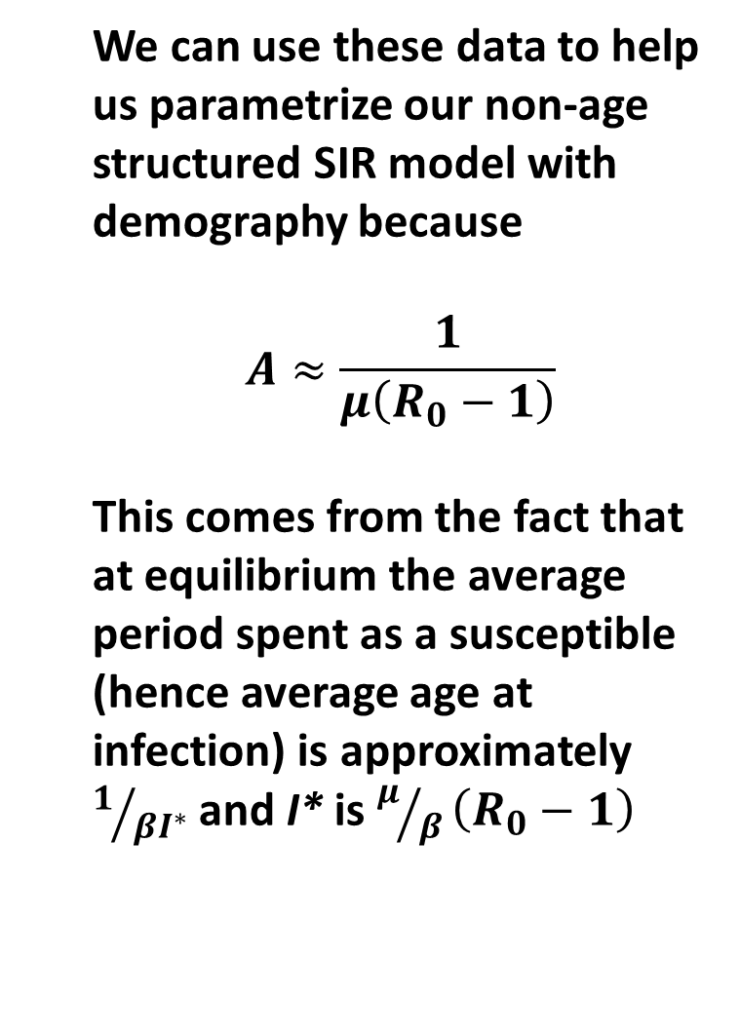
SIR model with demography: Average Age of Infection
We can use these data to help us parametrize our non-age structured SIR model with demography because
$$A≈\frac{1}{μ\left(R_{0}−1\right)}$$
This comes from the fact that at equilibrium the average period spent as a susceptible (hence average age at infection) is approximately $1/{βI^{∗}}$ and I* is $μ/β\left(R_{0}−1\right)$
% with Antibodies
Age

Slide 35
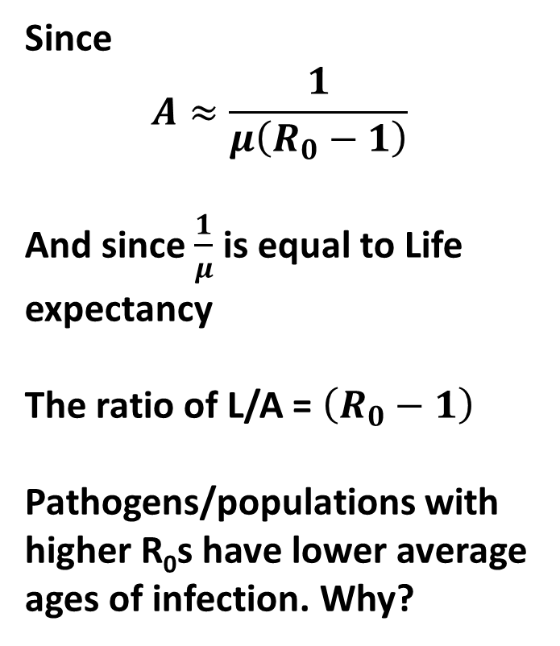
SIR model with demography: Average Age of Infection
Since
$$A≈\frac{1}{μ\left(R_{0}−1\right)}$$
And since $\frac{1}{μ}$ is equal to Life expectancy
The ratio of L/A = $\left(R_{0}−1\right)$
Pathogens/populations with higher R₀s have lower average ages of infection. Why?
% with Antibodies
Age

Slide 36
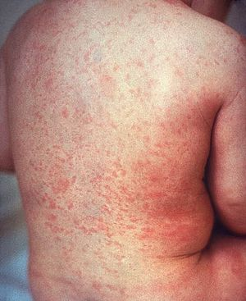
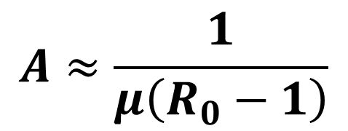
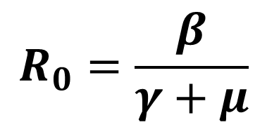
Practical Implication of Average Age of Infection: Example of Rubella
Rubella is typically a syndrome in children
However, pregnant women, if infected can have children with congenital rubella syndrome (cardiac defects, ocular defects, deafness, and other issues)
Rubella R₀ estimated at 6-7; L=70
A≈12.7 years
$$R_{0}=\frac{β}{γ+μ}$$
$$A≈\frac{1}{μ\left(R_{0}−1\right)}$$

Slide 37
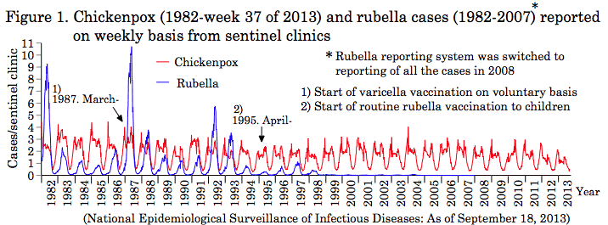
Practical Implication of Average Age of Infection: Example of Rubella

Slide 38
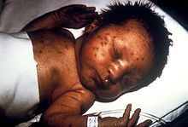
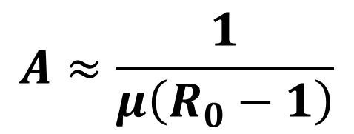
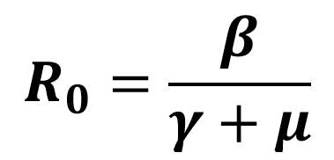
Practical Implication of Average Age of Infection: Example of Rubella
Reduction in transmission through vaccination, if insufficient to reach the critical threshold (R₀<<1), could increase the average age
Ex. If R₀=4, A≈ 23.3 years
$$R_{0}=\frac{β}{γ+μ}$$
$$A≈\frac{1}{μ\left(R_{0}−1\right)}$$

Slide 39
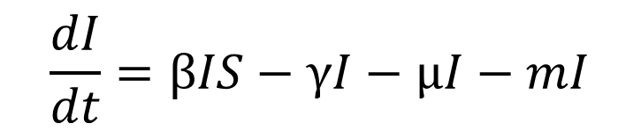
SIR model with demography: Excess Mortality due to Infection
One approach: add a term m
$$\frac{dS}{dt}=μ−βIS−μS$$
$$\frac{dI}{dt}=βIS−γI−μI−mI$$
$$\frac{dR}{dt}=γI−μR$$
Where m is a per capita disease-induced mortality rate for infected individuals

Slide 40
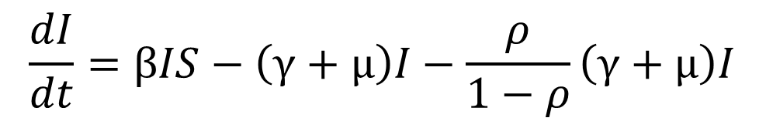
SIR model with demography: Excess Mortality due to Infection
Another PREFERRED approach: add a term ρ
$$\frac{dS}{dt}=μ−βIS−μS$$
$$\frac{dI}{dt}=βIS−\left(γ+μ\right)I−\frac{ρ}{1−ρ}\left(γ+μ\right)I$$
$$\frac{dR}{dt}=γI−μR$$
Where ρ is the probability of dying from the infection before either recovering or dying of natural causes

Slide 41
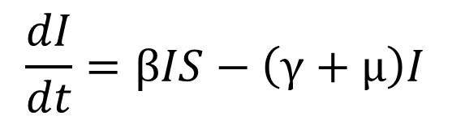
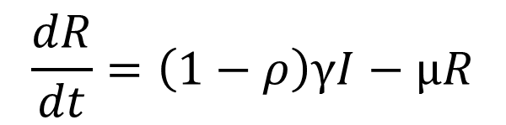
SIR model with demography: Excess Mortality due to Infection
If excess mortality due to infection generally occurs late in the infectious period, then we can write our equations like
$$\frac{dS}{dt}=μ−βIS−μS$$
$$\frac{dI}{dt}=βIS−\left(γ+μ\right)I$$
$$\frac{dR}{dt}=\left(1−ρ\right)γI−μR$$

Slide 42
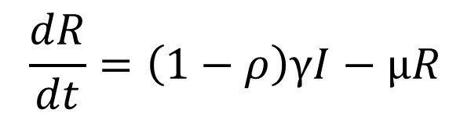
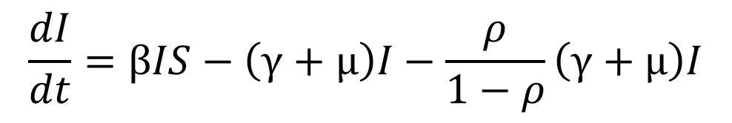
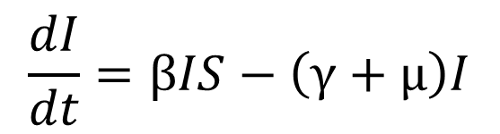
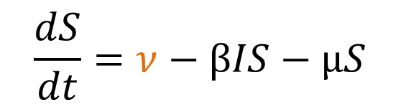

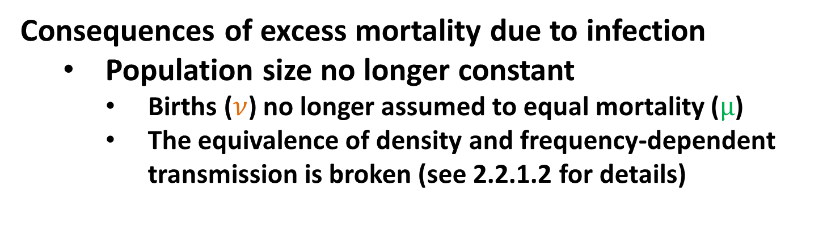
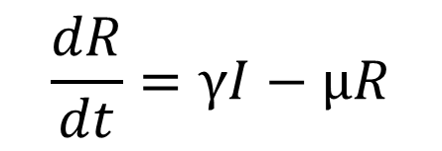
SIR model with demography: Excess Mortality due to Infection
Consequences of excess mortality due to infection
Population size no longer constant
Births ($ν$) no longer assumed to equal mortality ($μ$)
The equivalence of density and frequency-dependent transmission is broken (see 2.2.1.2 for details)
$$\frac{dS}{dt}=ν−βIS−μS$$
$$\frac{dS}{dt}=ν−βIS−μS$$
$$\frac{dI}{dt}=βIS−\left(γ+μ\right)I−\frac{ρ}{1−ρ}\left(γ+μ\right)I$$
$$\frac{dI}{dt}=βIS−\left(γ+μ\right)I$$
$$\frac{dR}{dt}=γI−μR$$
$$\frac{dR}{dt}=\left(1−ρ\right)γI−μR$$

Slide 43
SIR model with demography: Excess Mortality due to Infection
Consequences of excess mortality due to infection
Population size no longer constant
Births ($ν$) no longer assumed to equal mortality ($μ$)
The equivalence of density and frequency-dependent transmission is broken (see 2.2.1.2 for details)
$$\frac{dS}{dt}=ν−βIS−μS$$
$$\frac{dS}{dt}=ν−βIS−μS$$
The care we need to take about density vs. frequency-dependent transmission will continue for the rest of the examples in this lecture
$$\frac{dI}{dt}=βIS−\left(γ+μ\right)I−\frac{ρ}{1−ρ}\left(γ+μ\right)I$$
$$\frac{dI}{dt}=βIS−\left(γ+μ\right)I$$
$$\frac{dR}{dt}=γI−μR$$
$$\frac{dR}{dt}=\left(1−ρ\right)γI−μR$$

Slide 44
Extensions to sir models with demography

Slide 45
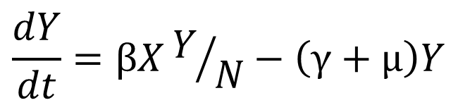
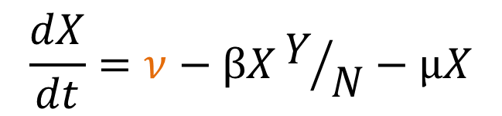
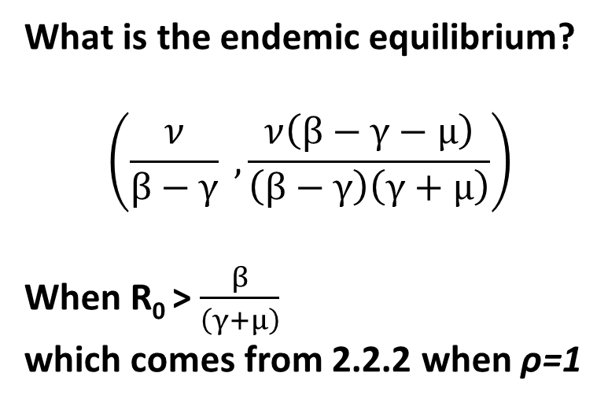
Models for Chronic Infections
X
βY/N
Y
γ
ν
µ
µ
$$\frac{dX}{dt}=ν−βXY/N−μX$$
What is the endemic equilibrium?
$$\left(\frac{ν}{β−γ} , \frac{ν\left(β−γ−μ\right)}{\left(β−γ\right)\left(γ+μ\right)}\right)$$
When R₀ > $\frac{β}{\left(γ+μ\right)}$
which comes from 2.2.2 when ρ=1
$$\frac{dY}{dt}=βXY/N−\left(γ+μ\right)Y$$

Slide 46
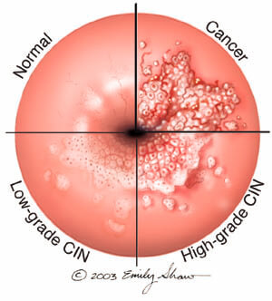

Relevance of Models for Chronic Infections
Long-term chronic infections
HCV (hepatitis c virus)
HPV (human papillomavirus)
Short-term highly fatal infections
Ebola
Bovine Spongiform Encephalopathy

Slide 47



Models for Infections without Immunity
S
βI
I
γ
$$\frac{dS}{dt}=γI−βSI$$
What is the endemic equilibrium?
$$\left(\frac{γ}{β} , 1−\frac{γ}{β}\right)$$
When R₀ > $\frac{β}{γ}$ and endemic equilibrium reached w/o oscillations
$$\frac{dI}{dt}=βSI−γI$$

Slide 48


SIR model with demography: Waning Immunity
ω
S
βI
I
γ
R
µ
µ
µ
µ
$$\frac{dS}{dt}=μ+ωR−βIS−μS$$
When ω is 0: SIR with demography
When ω is infinity: SIS with demography
SIR with demography and waning immunity has oscillations whose period is more complicated to describe (see 2.4)
$$\frac{dI}{dt}=βIS−γI−μI$$
$$\frac{dR}{dt}=γI−ωR−μR$$

Slide 49


Relevance of Models without Immunity or with Rapidly Waning Immunity
Gonorrhea
Syphilis

Slide 50
Important Announcements

